Slide 1
Tan Ratio
Miss L
Year 12

Slide 2
Learning Intentions
Students will be able to
Find the missing side using Tan Ratio

Slide 3
24
7
30
Trigonometry
Date:
EQ – How do you work out the missing side using the Tangent ratio?
We can use trigonometry to find missing angles and lengths of triangles.
Trigonometry uses three functions, these are called:
Sine (shortened to Sin and pronounced “sign”)
Cosine (shortened to Cos)
Tangent (shortened to Tan)
How do we find missing sides and angles?

Slide 4
24
7
30
Trigonometry
Date:
EQ – How do you work out the missing side using the Tangent ratio?
Labelling the sides
Hypotenuse
What we call the other two sides will change depending on which angle we are working with, for example..
Opposite
ϴ
Adjacent

Slide 5
24
7
30
Trigonometry
Date:
EQ – How do you work out the missing side using the Tangent ratio?
Labelling the sides
ϴ
Hypotenuse
What we call the other two sides will change depending on which angle we are working with, for example..
Adjacent
Opposite

Slide 6
What is the side marked with an X?
X
ϴ
Adjacent
Opposite
A)
B)
Hypotenuse
C)

Slide 7
What is the side marked with an X?
ϴ
X
Hypotenuse
Opposite
A)
B)
Adjacent
C)

Slide 8
What is the side marked with an X?
X
ϴ
Hypotenuse
Opposite
A)
B)
Adjacent
C)

Slide 9
What is the side marked with an X?
ϴ
X
Opposite
Adjacent
A)
B)
Hypotenuse
C)

Slide 10
What is the side marked with an X?
X
ϴ
Adjacent
Opposite
A)
B)
Hypotenuse
C)

Slide 11
What is the side marked with an X?
X
ϴ
Opposite
Adjacent
A)
B)
Hypotenuse
C)

Slide 12
What is the side marked with an X?
ϴ
X
Opposite
Adjacent
A)
B)
Hypotenuse
C)

Slide 13
What is the side marked with an X?
X
ϴ
Opposite
Hypotenuse
A)
B)
Adjacent
C)

Slide 14
What is the side marked with an X?
ϴ
X
Hypotenuse
Adjacent
A)
B)
Opposite
C)

Slide 15
What is the side marked with an X?
X
ϴ
Hypotenuse
Opposite
A)
B)
Adjacent
C)

Slide 16


Slide 17
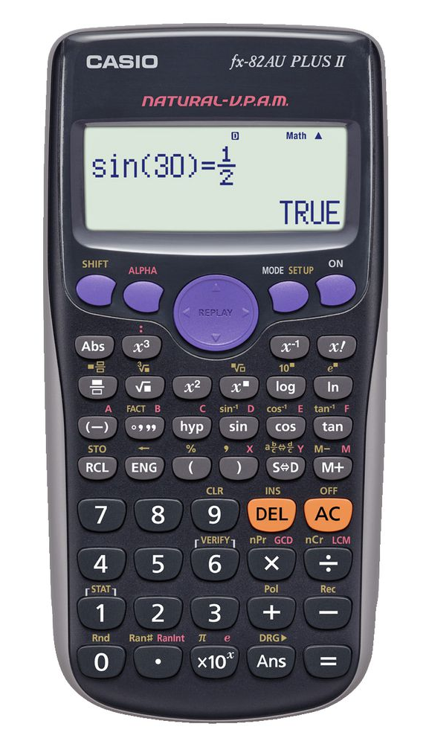
Your calculator must be set to Deg
Shift – mode
Select 3:Deg so press 3 on the calculator

Slide 18
24
7
30
Trigonometry
Date:
EQ – How do you work out the missing side using the Tangent ratio?
We use Tangent when we have the Opposite and Adjacent lengths.
10cm
Opposite
Adjacent
Tan ϴ=
50˚
6.4cm (1dp)

Slide 19
Practice
x
We can use Tan as the question involves the Adjacent and Opposite lengths
53˚
11cm
X
11
The rule we use is:
Tan53=
Opposite
Adjacent
Tanϴ=
11 x Tan 53 = X
14.6 cm (1dp)= X

Slide 20
Practice
21cm
We can use Tan as the question involves the Adjacent and Opposite lengths
35˚
21
A
A
Tan35=
The rule we use is:
A x Tan35 = 21
Opposite
Adjacent
Tanϴ=
A = 21
Tan35
A= 29.99 cm (2dp)

Slide 21
Use Tangent to find the missing lengths on these triangles:
Opposite
Adjacent
Tanϴ=
60˚
O
A
42˚
15cm
11cm

Slide 22
Task
Complete the work sheet ☺

